Slide 1
CONGENITAL HEART DISEASES
Dr Eman MS Muhammad

Slide 2
Etiology:
The real cause is unknown, but the following factors are blamed:
Viral infection of the mother in the first 3 months by: German measles (rubella) or Coxsachie virus.
Certain medications or drugs; tertatogenic drugs such as thalidomide, cortisone.
Alcohol and/or tobacco.
Nutritional and vitamin deficiencies in pregnancy.
Maternal diabetes.
Down syndrome, Turner syndrome, and Marfan syndrome.
Syphilis.

Slide 3
Classifications:
Non-cyanotic group:
Left to right shunt:
Atrial septal defect (ASD).
Ventricular septal defect (VSD).
Patent ductus arteriosus (PDA).

Slide 4
No shunt:
Pulmonary stenosis.
Aortic stenosis.
Coarctation of the aorta.

Slide 5
Cyanotic group: (right to left shunt)
Fallot’s trilogy.
Fallot’s tetralogy.
Eisenmenger’s syndrome.
Transposition of great vessels.

Slide 6
Cyanotic group

Slide 7
Fallot’s Tetralogy
The commonest anomaly of the cyanotic group is the tetralogy of Fallot.
It is composed of:
Obstruction of the outflow tract of the RV, usually from stenosis of the pulmonary valve, or obstruction of the infandibular part of the RV.
This results in right ventricular hypertrophy and the pressure in this chamber is raised.

Slide 8
Some of the un-oxygenated blood in the chamber is shunted into the aorta through a high interventricular septal defect.
The aorta partially overrides the septal defect, and so in addition to receiving oxygenated blood from the LV, it also receives venous blood from the RV.

Slide 9
In extreme cases, the the pulmonary orifice and artery may be atretic, and blood reaches the lungs from the aorta through the PDA.
In about 25% of cases of Fallot there is right aortic arch.

Slide 10
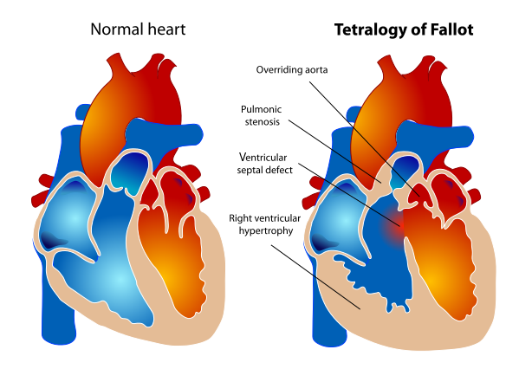

Slide 11
Effects:
Right to left shunting of blood, decreased pulmonary blood flow, and increased aortic blood volume.
The clinical severity depends on the degree of pulmonary stenosis.
Secondary polycythemia and clubbing of figures due to hypoxia.
Increased risk of infective endocarditis, and systemic embolization.

Slide 12
Fallot’s Trilogy
Fallot’s Trilogy is composed of:
Pulmonary stenosis.
Right ventricular hypertrophy.
Atrial septal defect.

Slide 13
Eisenmenger’s Syndrome
Eisenmenger's syndrome, ES is defined as a long-standing left-to-right cardiac shunt caused by a congenital heart defect (typically by a VSD, ASD, or less commonly, PDA) causes pulmonary hypertension and eventual reversal of the shunt into a cyanotic right-to-left shunt.

Slide 14
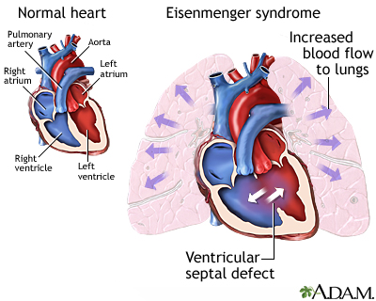

Slide 15
Transposition of great vessels
This anomaly results from failure of the proximal aorta and pulmonary artery to undergo the spiral rotation necessary for establishment of their correct relationships with the ventricles.
In consequence, the aorta arises from the RV, and the pulmonary artery from the LV.
Such condition alone is incompatible with extra-uterine life.

Slide 16
Sometimes it may be compensated for a time by persistence of the PDA, patent foramen oval, ASD, and/or VSD.
The greater the volume of the shunt, the better the admixture of the arterial blood and venous blood and the less marked the cyanosis.

Slide 17
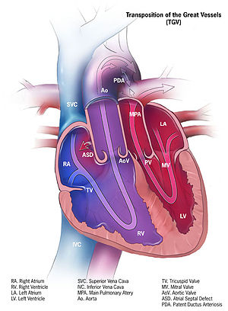

Slide 18
Non-cyanotic group

Slide 19
Patent Ductus Arteriosus (PDA)
There is a persistent communication between the descending thoracic aorta and the pulmonary artery that results from failure of normal physiologic closure of the fetal ductus.
It may be the only abnormality present.
It may coexist with other anomalies.
It shunt blood from the aorta to the pulmonary artery.

Slide 20
The LV ↑ its output to compensate for the shunted blood so it undergoes hypertrophy and dilatation.
The increased strain on the RV causes its hypertrophy and dilatation.
Failure to close the ducts leads to HF.
There is also ↑ risk of endocarditis of the ductus.
Ductus is usually present immediately beyond the origin of left subclavian artery.
Such a patient may have a cyanotic tinge in the nail-beds of the toes, but not in those of the hands.

Slide 21
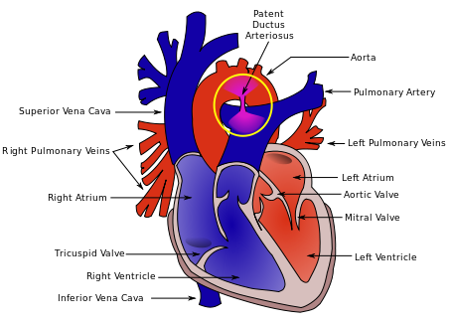

Slide 22
Atrial Septal Defect (ASD)
This is the commonest congenital malformations of the heart.
Even when the defect is large, it appears to have little effect on the circulation.
The blood flows from the left to the right atrium (RA).
The RA undergoes hypertrophy and dilatation.
Hypertrophy and dilatation of the RV with loud systolic murmur.

Slide 23
The pulmonary artery is dilated and atherosclerotic, while the aorta is small.
The overworked RV fails off, this causes ↓ in the blood supply to the lung.

Slide 24
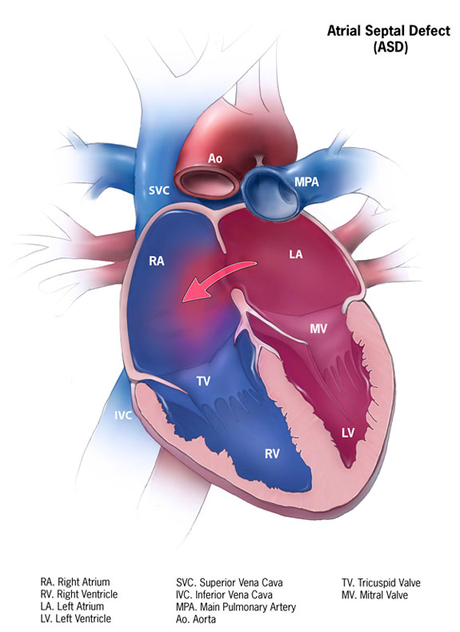

Slide 25
Ventricular Septal Defect (VSD)
A high septal defect is frequently part of other congenital anomaly such as Fallot’s tetralogy.
There is two types:
Small defect: Rare and occurs in the muscular part of the septum.
Cardiac hypertrophy does not occur (Roger’s disease).
Big defect: More common and occurs in the membranous septum just below the aortic valve.

Slide 26
Blood is shunted from the LV to the RV to the pulmonary artery causing slight enlargement.
SIE may develop on the endocardial surface of the RV opposite the defect.
Clinically it produces thrill and a loud systolic murmur.

Slide 27
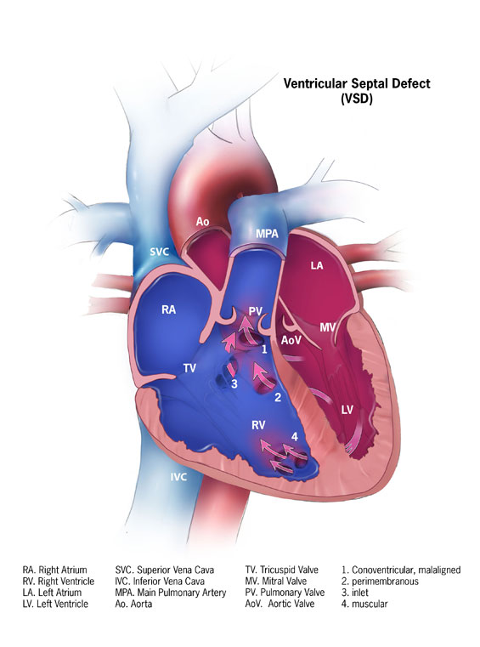

Slide 28
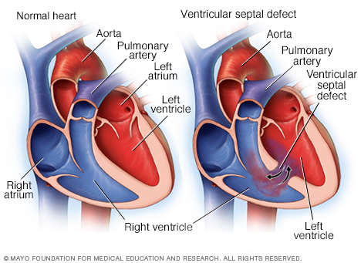

Slide 29
Coarctation (stenosis) of the aorta)
All degrees of narrowing up to the degree of atresia may occur.
Infantile type:
Slight narrowing of the aorta between the left subclavian artery and the ductus arteriosus (proximal to the ducutus) which remains patent.
It is common and occurs predominantly in males.
The blood flow through the ductus from the pulmonary artery to the aorta.
This defect is usually incompatible with life.

Slide 30
Adult type:
The narrowing is distal to the ductus which is closed.
With severe narrowing opening of the collateral from the carotid and subclavian arteries links the aorta above and below the narrowed segment.
Blood pressure increased in the arms, head and neck and decreased blood pressure in the legs.
So the pulse in the legs is poor compared with that in the arms.
Death results from LSHF, aortic aneurysm or dissection, cerebral hemorrhage or SIE.

Slide 31
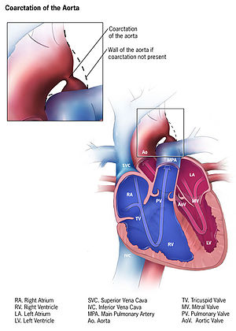

Slide 32
Complications of congenital heart diseases:
Cyanosis: develops early in life in Fallot’s tetralogy.
Predisposition to SIE.
Heart failure.
Pulmonary hypertension.

Slide 33
TUMOURS OF THE HEART
Primary Tumors:
They are extremely rare and include myxoma, fibroma, lipoma, rhabdomyoma, angiosarcoma and rhabdomyosarcoma.
Secondary Tumors:
They occur in about 5% of patients dying of cancer.
The commonest are bronchial carcinoma, breast carcinoma, malignant melanoma, lymphoma and leukemia.

Slide 34
Thank you

